Slide 1

RANI CHANNAMMA UNIVERSITY, BELAGAVI
School of Mathematics and Computing Sciences
DEPARTMENT OF COMPUTER SCIENCE
Presentation On
“Image Slide Show”
Submitted by
Mr. Appayya Badiger.
MSc 1st Semester
December -2018

Slide 2
Problem Definition:
Creating the html document with java script the web page consisting of “IMAGE SLIDE SHOW” with associated text message.
Using Four Buttons(Play,Stop,Next, Previous)

Slide 3
Objective:
The main objective of the project is of the Image Slideshow. A well-organized slide show allows a presenter to fit visual The old adage "A picture is worth a thousand words" holds true, in that a single image can save a presenter from speaking a paragraph of descriptive details.

Slide 4
The Purpose of Project:
The purpose was generating awareness as well as improving the efficiency of welfare services for women and girl child in the indian society.

Slide 5
System Architecture:
Software And Hardware Requirements
Software requirements:
Languages :HTML,JavaScript,CSS
Operating System :Window 7 Higher Version
Editor :Notepad++
Hardware requirements:
Processor :Core i5 processor
Hard Disk :4GB.
RAM :2 GB

Slide 6
Image Slide Show…

Slide 7
What is Slide Show view?
A collection of pages arranged in sequence that contain text and images for presenting to an audience.

Slide 8
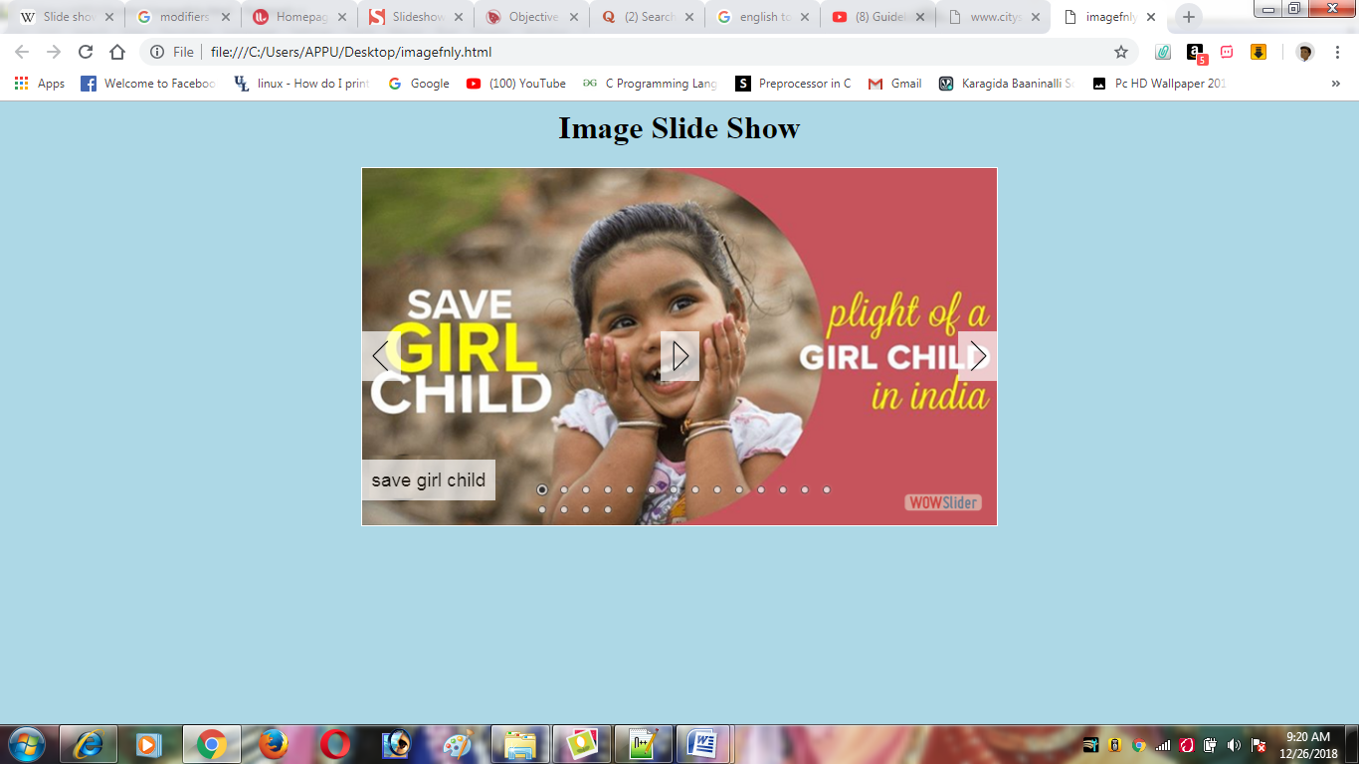
Screen Shots:1

Slide 9
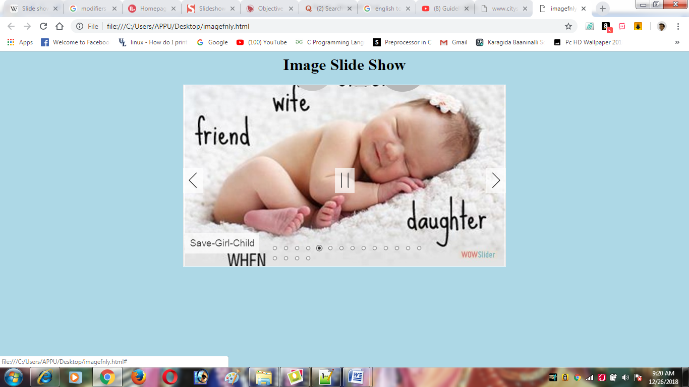
Screen Shots: 2

Slide 10
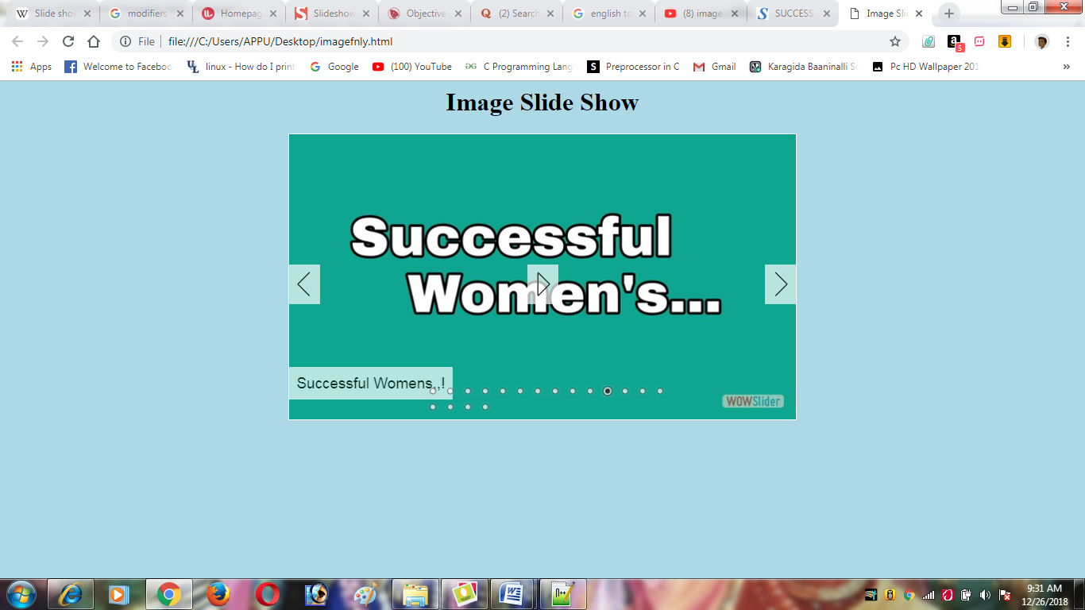
Screen Shots: 3

Slide 11
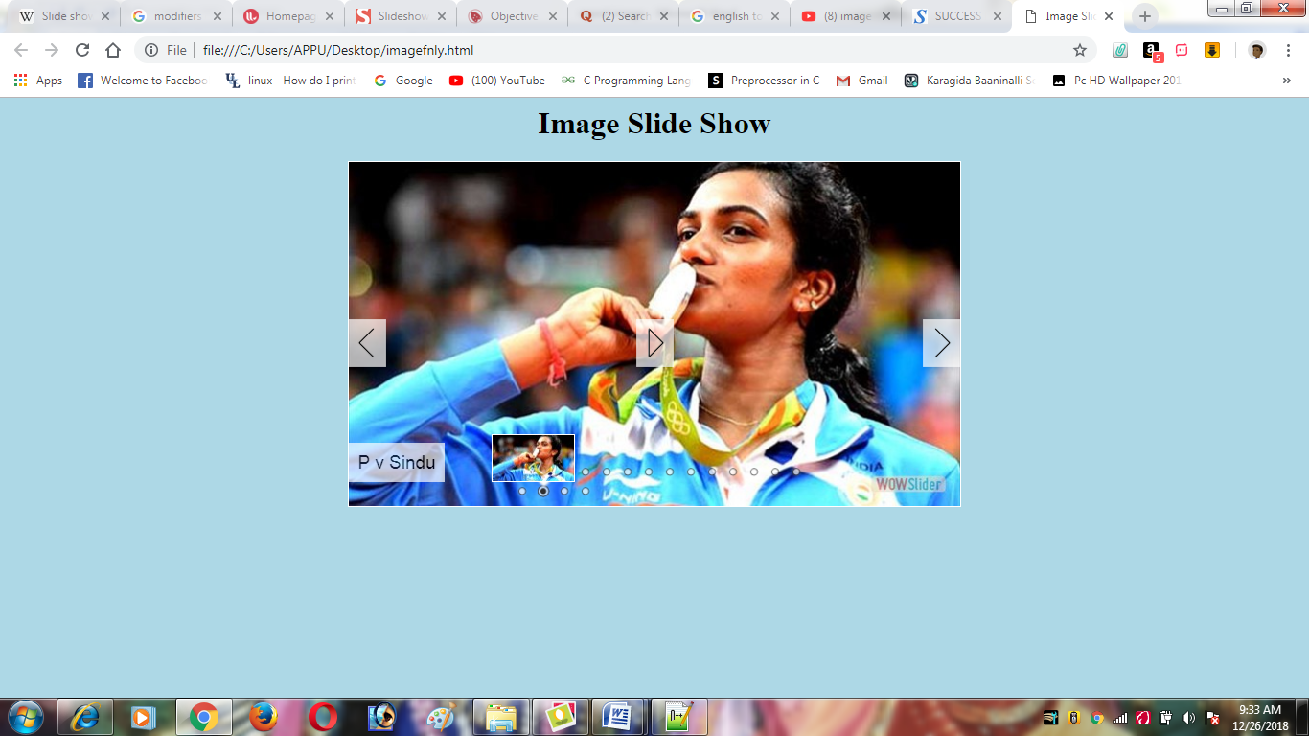
Screen Shots:4

Slide 12
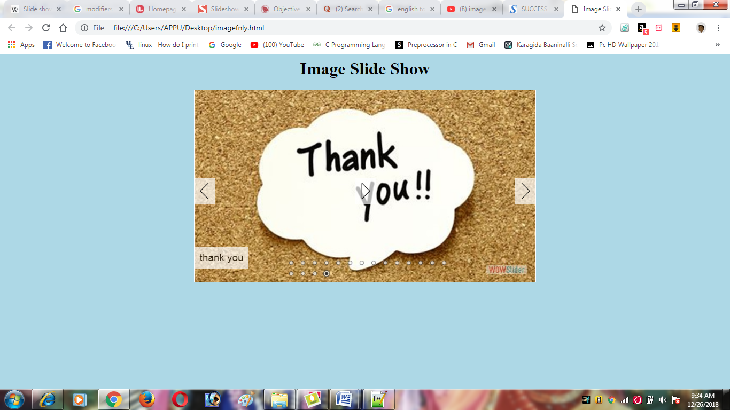
Screen Shots:5

Slide 13
Thank You…

